Slide 1
Maven
-Kranthi Kavuri

Slide 2
What is Maven
Maven is a project development management and comprehension tool. Based on the concept of a project object model: builds, dependency management, documentation creation, site publication, and distribution publication are all controlled from the pom.xml declarative file. Maven can be extended by plugins to utilize a number of other development tools for reporting or the build process.

Slide 3
Maven Objectives
Maven’s primary goal is to allow a developer to comprehend the complete state of a development effort in the shortest period of time.
Making the build process easy
Providing a uniform build system
Providing quality project information
Providing guidelines for best practices development
Allowing transparent migration to new features

Slide 4
Maven Concepts
All build systems are essentially the same:
Compile Source code
Copy Resource
Compile and Run Tests
Package Project
Deploy Project
Cleanup
Describe the project and configure the build
You don’t script a build
Maven has no concept of a condition
Plugins are configured

Slide 5
Create mvn projects
Create Java project:
mvn archetype:generate -DgroupId=org.yourcompany.project -DartifactId=application
Create web project:
mvn archetype:generate -DgroupId=org.yourcompany.project -DartifactId=application -DarchetypeArtifactId=maven-archetype-webapp
Create archetype from existing project:
mvn archetype:create-from-project

Slide 6
Maven Lifecycle Phases
These are the most common default lifecycle phases executed.
validate: validate the project is correct and all necessary information is available
compile: compile the source code of the project
test: test the compiled source code using a suitable unit testing framework. These tests should not require the code be packaged or deployed
package: take the compiled code and package it in its distributable format, such as a JAR.
integration-test: process and deploy the package if necessary into an environment where integration tests can be run
verify: run any checks to verify the package is valid and meets quality criteria
install: install the package into the local repository, for use as a dependency in other projects locally
deploy: done in an integration or release environment, copies the final package to the remote repository for sharing with other developers and projects.
There are two other Maven lifecycles of note beyond the default list above. They are
clean: cleans up artifacts created by prior builds
site: generates site documentation for this project

Slide 7
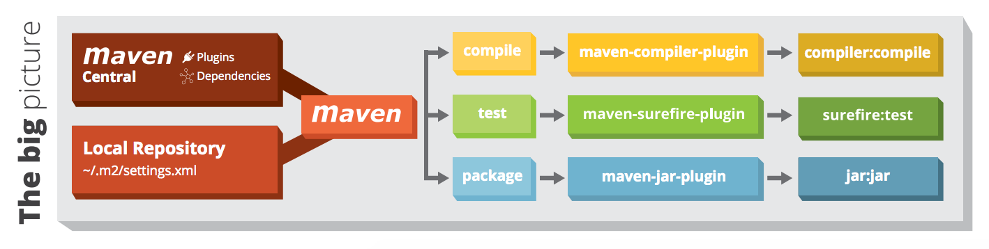
The big Picture

Slide 8
Maven Conventions
Maven is opinionated about project structure
target: Default work directory
src: All project source files go in this directory
src/main: All sources that go into primary artifact
src/test: All sources contributing to testing project
src/main/java: All java source files
src/main/webapp: All web source files
src/main/resources: All non compiled source files
src/test/java: All java test source files
src/test/resources: All non compiled test source files

Slide 9
Maven Artifact
An artifact is a file, usually a JAR, that gets deployed to a Maven repository.
A Maven build produces one or more artifacts, such as a compiled JAR and a "sources" JAR.
Each artifact has a group ID (usually a reversed domain name, like com.example.foo), an artifact ID (just a name), and a version string. The three together uniquely identify the artifact.
A project's dependencies are specified as artifacts.

Slide 10
Installing Maven
cd ~
wget http://www-us.apache.org/dist/maven/maven-3/3.5.0/binaries/apache-maven-3.5.0-bin.tar.gz
chmod 755 apache-maven-3.5.0-bin.tar.gz
tar -xvf apache-maven-3.5.0-bin.tar.gz
ln -s apache-maven-3.5.0 maven350
export PATH=~/apache-maven-3.5.0/bin:$PATH
mvn -v

Slide 11
Creating a Project
> mvn archetype:generate -DgroupId=com.mycompany.app -DartifactId=my-app -DarchetypeArtifactId=maven-archetype-quickstart -DinteractiveMode=false

Slide 12
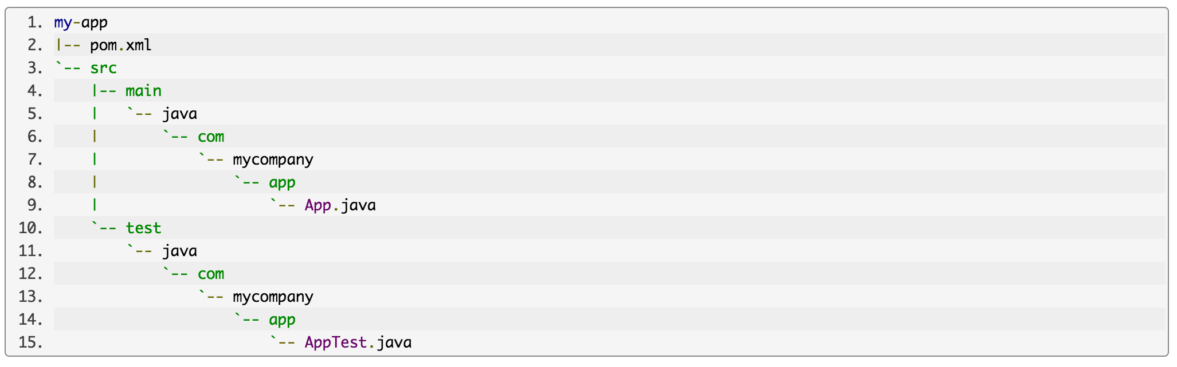
Standard Project Structure
The src/main/java directory contains the project source code, the src/test/java directory contains the test source, and the pom.xml file is the project's Project Object Model, or POM.

Slide 13
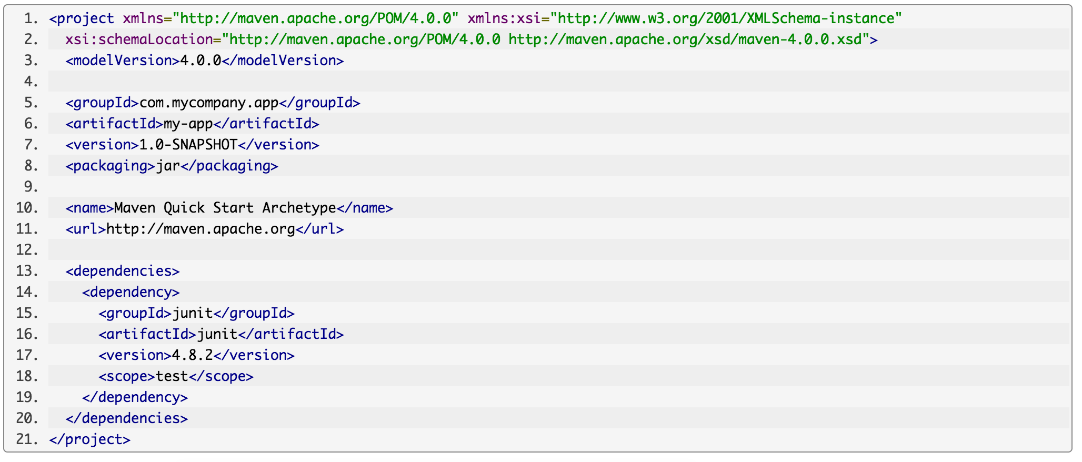
POM
The pom.xml file is the core of a project's configuration in Maven. It is a single configuration file that contains the majority of information required to build a project in just the way you want. The POM is huge and can be daunting in its complexity, but it is not necessary to understand all of the intricacies just yet to use it effectively. This project's POM is:

Slide 14
What did I just do?
You executed the Maven goal archetype:generate, and passed in various parameters to that goal. The prefix archetype is the plugin that contains the goal. If you are familiar with Ant, you may conceive of this as similar to a task. This goal created a simple project based upon an archetype. Suffice it to say for now that a plugin is a collection of goals with a general common purpose.

Slide 15
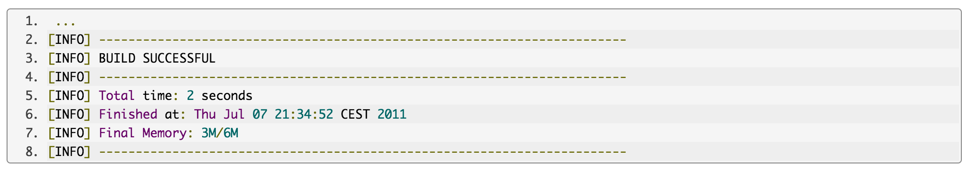
Build the Project
> mvn package
The command line will print out various actions, and end with the following:

Slide 16
Package phase
Unlike the first command executed (archetype:generate) you may notice the second is simply a single word - package. Rather than a goal, this is a phase. A phase is a step in the build lifecycle, which is an ordered sequence of phases. When a phase is given, Maven will execute every phase in the sequence up to and including the one defined. For example, if we execute the compile phase, the phases that actually get executed are:
validate
generate-sources
process-sources
generate-resources
process-resources
compile

Slide 17
Run the app
You may test the newly compiled and packaged JAR with the following command:
> java -cp target/my-app-1.0-SNAPSHOT.jar com.mycompany.app.App
Which will simply print the quintessential:
>> Hello World!

Slide 18
Generate the site
Phases are actually mapped to underlying goals. The specific goals executed per phase is dependent upon the packaging type of the project. For example, package executes jar:jar if the project type is a JAR, and war:war if the project type is - you guessed it - a WAR.
An interesting thing to note is that phases and goals may be executed in sequence.
> mvn clean dependency:copy-dependencies package
This command will clean the project, copy dependencies, and package the project (executing all phases up to package, of course).
Generating the Site:
> mvn site

Slide 19
Assignment
Follow the steps in the below link to replicate the example: https://maven.apache.org/guides/getting-started/maven-in-five-minutes.html
Take a screenshot for the command “env” and attach along with the example screen’s in a word document.
For a good grade, you can come up with any other maven example with detailed explanation.

